Slide 1
Simulation of Wi-Fi based TSN Mechanisms using
NS-3 Simulator
Prof. Dr.-Ing. Axel Sikora
Manuel Schappacher
Jubin Sebastian Elayanithottathil
Aneemesh Vidyarthi

Slide 2
Contents
Background
Implementation
  Composition
    Architecture
    Notes
  Methodology
    Points
    Application Diagram
References

Slide 3
Background
ivESK works on Time Sensitive Networks (TSN) for industrial communications
TSN uses accurate time sync (802.1AS) and scheduling like Time Aware Shapers (802.1Qbv)
TSN is technology-agnostic but Wi-Fi has challenges like asymmetric paths, unreliable links
Wi-Fi has different protocols to fulfil TSN goals e.g. Fine Time Measurement (FTM), Access Categories (AC) and lacks support for frame-preemption.
The goal is to create ns-3 simulations to model Wi-Fi based TSN.
One avenue of optimization: application-based definitive priority on traffic from wireless nodes - Wi-Fi QoS

Slide 4
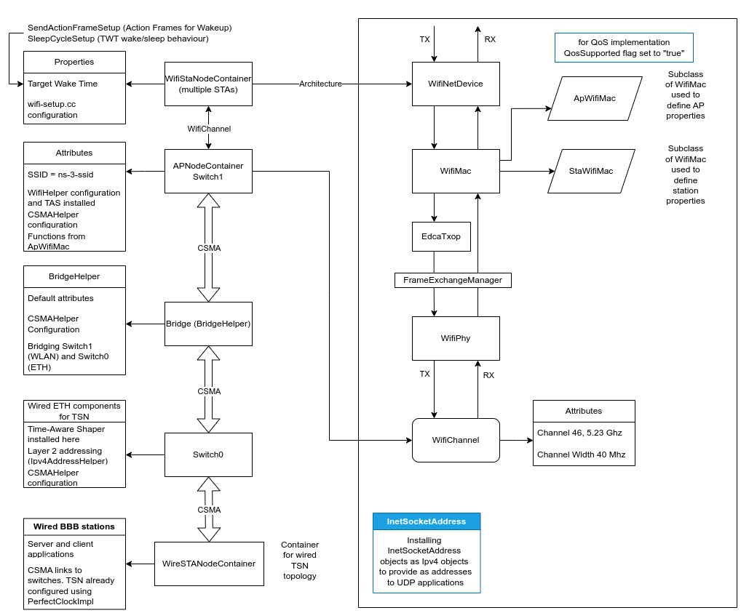
Implementation – Composition – Architecture
The architecture details the class-object structure used to design the physical topology that is used in the simulation
The QoS setting is enabled by:
modifying wifi-setup.cc,
porting qos-txop.cc (deprecated),
InetSocketAddress ToS parameters
Access Category Matrix, native to ns-3.26+ defines user priorities.
QoS-txop.cc defines ACs on a hardware level while InetSocketAddress does it on a per-application, per-port basis.
- Advantages...

Slide 5
Implementation – Composition – Notes
1 broadcasting AP, several STA endpoints
  Classified for real-time, best effort etc for different use cases per endpoint (QoS)
  TSN switches connected to TSN WLAN region
  Clocks per node. (GM is TSN switch as per gPTP specification)
  TWT based sleep/wake for STAs (Wi-Fi 6)
  FTM to obtain Wi-Fi communication timestamps is to be implemented using ftm-sync.h
Time-Aware Shaper
  TAS (IEEE 802.1Qbv) on both switches, using schedules
  Time synchronization with callback to Simulator::Now()*
Wi-Fi QoS implementation
  Application flow between wired and wireless nodes with InetSocketAddress objects
  TOS socket tagging (simulated, port-specific) from matrix specified in ns-3 docs.
Build system ported to ns-3.36.1 (new CMake-based ns3 system used instead of the older WAF system)
Testing: https://docs.google.com/spreadsheets/d/1KQKjGEhCIMj2iP7ncDUTTquqrSq4hpVmSAhxCtsc7W4/edit#gid=0

Slide 6
Implementation – Methodology – Points
TSN-enabled switch and nodes connected to Wi-Fi 6 AP with its own switch.
The simulation uses PerfectClockModel for time sync.
Attempt to implement Wi-Fi QoS on stations and AP to mitigate latency with traffic classification
  wifi-setup.cc – QosSupported flag on ApWifiMac and StaWifiMac objects that are used for initializing wireless device containers.
  ns3::WifiMacHelper defines access classes according to a matrix consisting of User Prio and AC
  InetSocketAddress objects define QoS per application, per port.
Time-Aware Shaper on wired and AP switches.
Wired and wireless stations talk to each other with different levels of priority.
Flow monitoring and packet capture. 7 UDP flows exist in the simulation.
Goals:
  Deterministic Networking
  Minimizing Jitter and Latency
  Application priority segregation

Slide 7
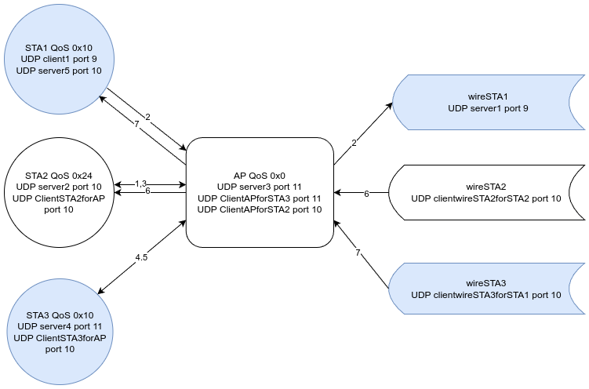
Implementation – Methodology – Application Diagram

Slide 8
Documentation and References
https://probable-tarsier-b33.notion.site/Wi-Fi-QoS-bridged-to-TSN-topology-fbee240c0fdf46f3a43604b78b685308?pvs=4
https://git.fortiss.org/iiot_external/detnetwifi-ns3 (initial code)
https://git.fortiss.org/iiot_external/ns-3-detnetwifi/documentation
https://www.nsnam.org/docs/3.34
https://www.nsnam.org/docs/3.36
IEEE 1588 documentation for standards used
https://www.researchgate.net/profile/Dennis-Krummacker/publication/348431501_TSN_Simulation_Time-Aware_Shaper_implemented_in_ns-3/links/5ffec2c0299bf140888ff7cd/TSN-Simulation-Time-Aware-Shaper-implemented-in-ns-3.pdf
https://groups.google.com/g/ns-3-users/c/YuD49ScDb1Y?pli=1 (debugging using WAF)
https://github.com/tkn-tub/wifi-ftm-ns3

